Slide 2
Oral Statements
Oral statements or discussion during the pre-bid meeting today will not be binding, nor will it change or affect the terms or conditions within the Plans and Specifications of this Project. Changes, if any, will be addressed in writing only via an Addendum.

Slide 3
Agenda
General Information
Small, Minority, Woman, and Veteran-Owned Business (SMWVB Participation)
Contract Requirements
Bid Packet Preparation
Addendums
Vendor Registration
Bid Opening Dates/Time
Technical Information

Slide 4
General Information
Non-Mandatory pre-bid meeting
Presentation and the attendance sheet will be posted to the SAWS website
Construction services being procured through low bid under Government Code 2269

Slide 5
General Information
Estimate: $1,247,524.41
Calendar days:
270 calendar days

Slide 6
Aspirational SMWB Goal
Industry | Aspirational SMWB Goal
Construction | 20%
The aspirational SMWB goal is 20% of your total bid price.
Notes:
Contracting

Slide 7
Accepted SMWVB Certification Agency
South Central Texas Regional Certification Agency
  MBE, WBE, SBE (Includes “HUB” Program)
Minimum Qualifications for SMWVB recognition:
SBE-Certified (even MBEs and WBEs)
Local office or local equipment yard

Slide 8
Good Faith Effort Plan (GFEP) FAQs
Q: Is the 20% SMWB goal mandatory?
A: No, but we ask prime contractors to do their best with good faith outreach efforts. If the goal is not met, proof of outreach efforts is required with the submittal.
Q: What if I am having trouble finding SMWB subcontractors?
A: Please email the SMWVB Program Manager with the scopes of work you are seeking. You will receive lists of local SMWVB-certified firms to contact.
Q: What if my business is SMWB-certified? Do I need to find SMWB subs?
A: If your firm is SMWVB-certified, you will most likely meet the goal. However, the GFEP is a required document, and a good faith outreach effort is still necessary.
Q: Do I need to include all my subcontractors in the GFEP or just those that qualify towards the
SMWB goal?
A: All subcontractors need to be included in the GFEP, even those that may not count towards the SMWB goal.
Q: What if I have questions about the GFEP?
A: Please contact the SMWVB Program Manager at 210-233-3420, or at Marisol.Robles@saws.org . GFEP questions can be asked at any time before the submittal is due.
Notes:
SMWB

Slide 9
Post Award: Subcontractor Payment & Utilization Reporting (S.P.U.R.) System
1. Subcontractor & Supplier Payment Tracking
2. Subcontractor and Supplier Additions or Substitutions
3. LCP Tracker
4. Must be Current and Accurate before Retainage is released https://saws.smwbe.com

Slide 10
Contract Requirements
Prevailing Wage Rate and Labor Standards – Section 2.10 of the General Conditions
Certified payroll to be submitted on weekly basis
Wage decisions are included within the specifications
Contractors to utilize LCP Tracker
Site visits are random and unannounced
Interviews will be Conducted and will be private & confidential
Payroll records are subject to review
All apprenticeship programs will need to be approved by Department of Labor prior to starting
Contractors are responsible for sub-contractor payroll
Late payrolls delay contractor payments from SAWS

Slide 11
Contract Requirements
Insurance requirements are found in Section 5.7 of the GCs
  Installation Floater coverage is required in lieu of Builder’s Risk
Contractor shall maintain insurance coverage during the construction of this Project
Insurance must be compliant prior to executing the contract
SAWS will ask for insurance prior to Board award to expedite execution of the contract
  Any deficiencies must be corrected prior to Board award

Slide 12
Bid Packet Preparation
Utilize the Bid Packet Checklist within the specifications
  Submit only items asked for at the time of the bid opening
  Remaining items will be submitted by Apparent Low Bidder within one (1) day of the bid opening
Double check all mathematical calculations and verify all extensions
Ensure Mobilization & Prep ROW Line Item does not exceed the percentage allowed
Statement of Bidder’s Experience forms are required
  Similar projects should match the scope/experience indicated on the SBE form
  References and contact information must be verified prior to submitting
Addendums are acknowledged on the Bid Proposal Signature Page

Slide 13
Addendum(s)
Revisions, Clarifications, Questions and Answers (Q&A’s)
Question deadline is October 9, 2020 by 10:00 A.M.
Addendum will be posted on SAWS’ website on October 16, 2020 by 3:00 P.M.
All questions should be sent in writing via email or fax.
Check the SAWS website regularly for addendum postings.
It is possible to have multiple addendums during the time frame in addition to the scheduled final addendum.

Slide 14
Upcoming Addendum
Revisions, Clarifications, Questions and Answers (Q&A’s)
Building wage decision will be removed and replaced with latest version that was issued on 9/11/2020.
“or until funds are exhausted, which ever comes first (delete if not applicable)” will be removed from the contract.
Remove request for Superintendent and Project Manager resume and request for baseline schedule from Supplemental Conditions.

Slide 15
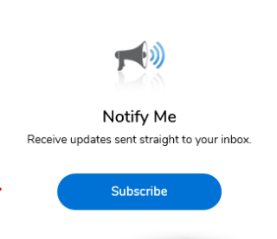
Vendor Registration & Notification (VRN)
Please register through SAWS’ Vendor Registration Program on the SAWS website at www.saws.org to ensure access to the latest information.
To receive updates on specific projects, registered vendors must ‘Subscribe’ to the project by selecting the project, and clicking ‘Subscribe’ under the Notify Me box.
https://apps.saws.org/Business_Center/Contractsol/

Slide 16
Bid Opening Dates/Times
October 23, 2020 at 2:00 PM
Bids will be received either electronically or sealed bids.
Electronic bids will be received via the secure SAWS FTP site.
FTP Site access will need to be requested by Thursday, October 22, 2020 2:00 PM
Bids may not be late
  Late bids will not be accepted and will be returned unopened
Sealed bids will be received by Contract Administration, 2800 U.S. Hwy 281 North, Tower II, Customer Service Building, via a drop box located on the left wall when walking through the first set of double glass doors of the main Tower II entry on the north side of the building.
  If delivering in person to SAWS, Bidders should allow sufficient travel time.

Slide 17
Contract Background
Sealed bids are requested by the San Antonio Water System for the construction of approximately 2,216-linear feet (LF) of 8-inch Sewer Main via Open Cut Construction and 1,469 LF of 8-inch Sewer via Pipe Bursting.
Project is part of the Consent Decree.
Contractor is to become familiar with the plans, specifications, and project locations.

Slide 18
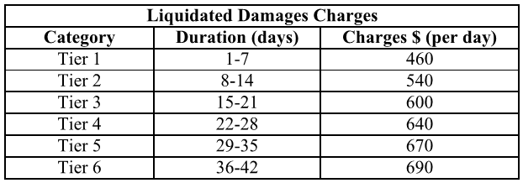
Contract Requirements
Supplemental Conditions
Liquidated damages will be assessed as follows for final completion extending beyond contract time of all Project Phases:
Any days tallied after 42 days will be assessed as a Tier 6 rate.

Slide 19
Contract Requirements
Special Conditions
Contractor to submit a completion report when the project is complete
  Pre and post MPEG-1 video and video logs
  Any tests and/or submittals specified in the Contract Documents
Payment
  The unit price cost for items shall include all the necessary incidental work as subsidiary to the item unless otherwise specifically called out in the plans or approved by SAWS
Performance Time
  A maximum of two (2) simultaneous project sites is permitted until substantial completion is achieved.

Slide 20
Project Sites
Site 1- La Sabre (Open Cut)
Site 2- Hall Park (Open Cut)
Site 3- Hall Park (Open Cut)
Site 4- Hall Park (Open Cut)
Site 5- W. Commerce St. (Open Cut)
Site 6- Darwin (Pipe Bursting)
Site 7- Gillette (Open Cut)
Site 8- Oletha (Open Cut)

Slide 21
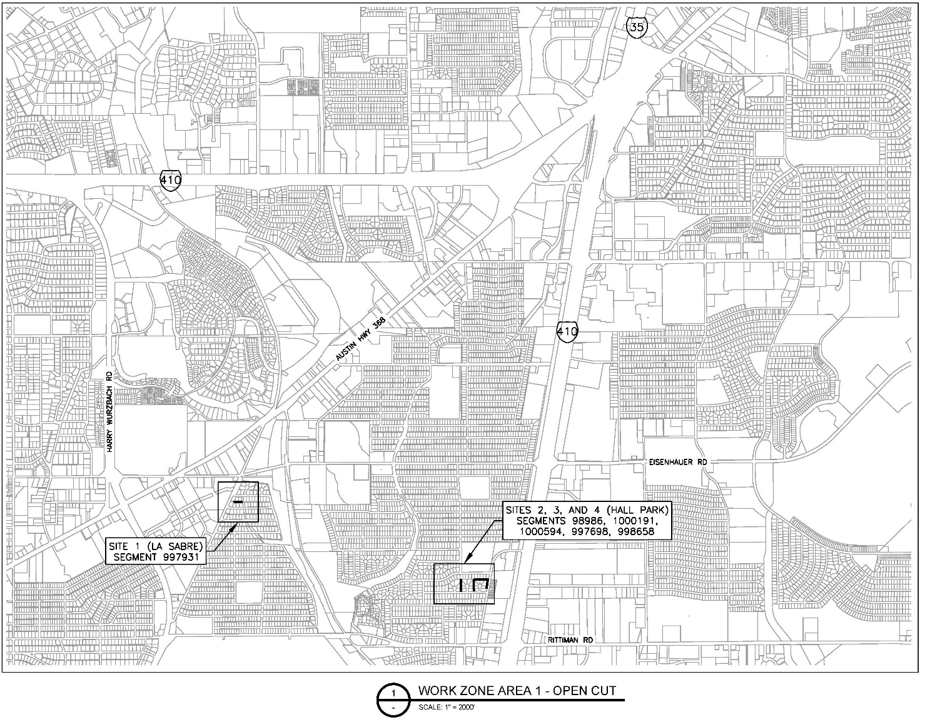
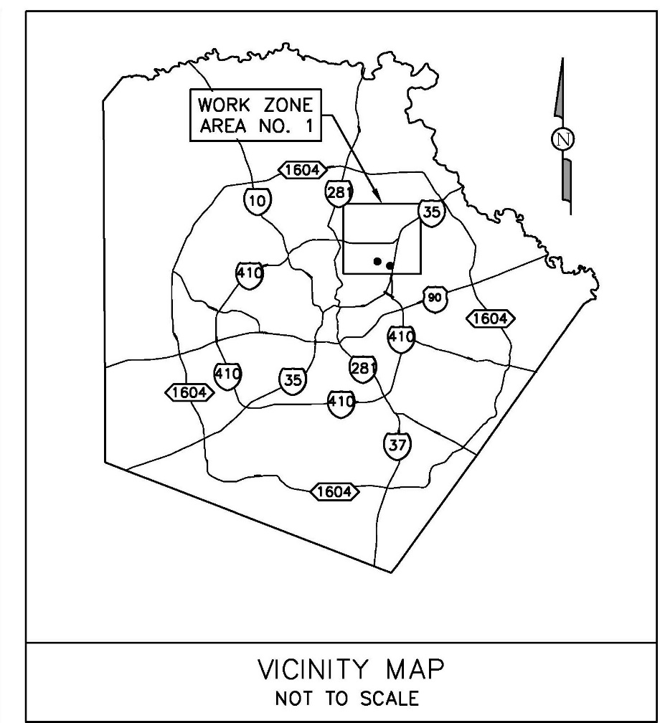
Location (Work Zone 1)

Slide 22
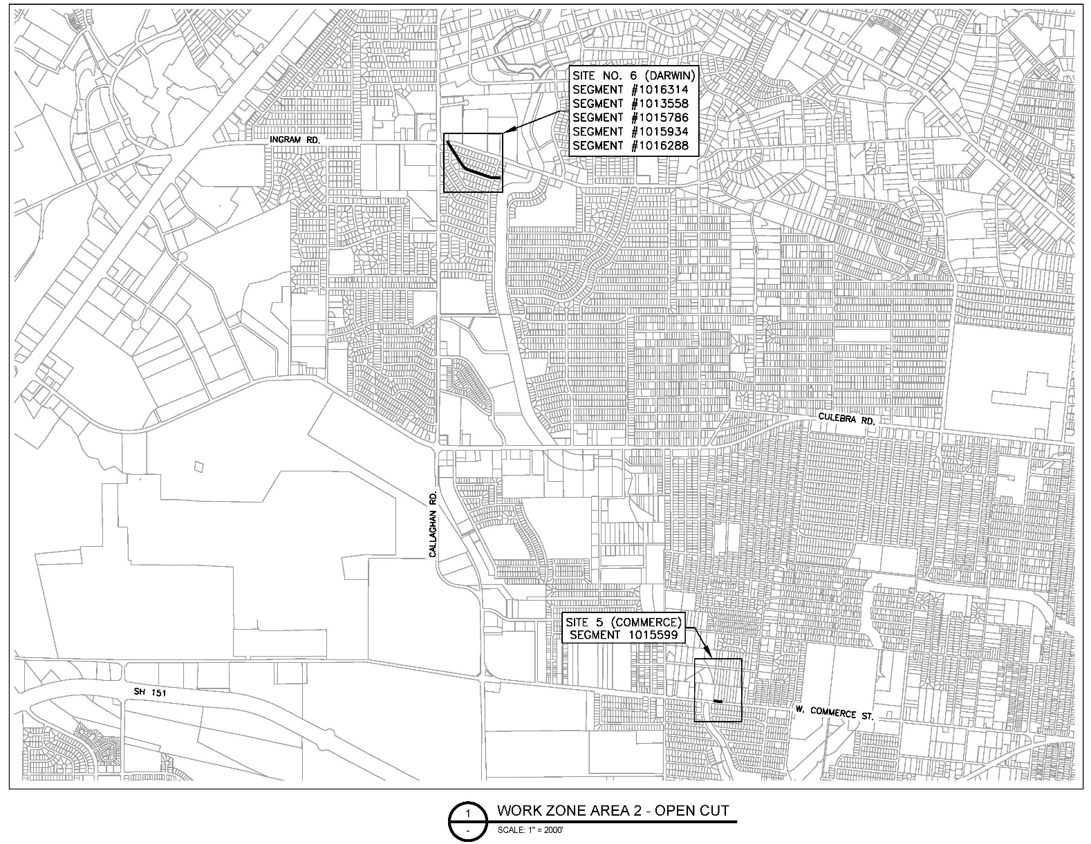
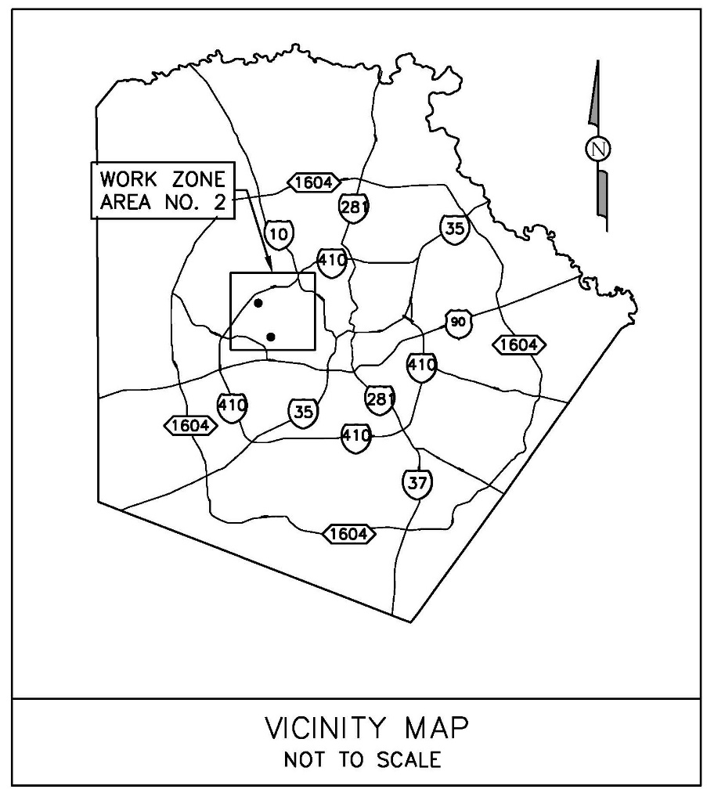
Location (Work Zone 2)

Slide 23
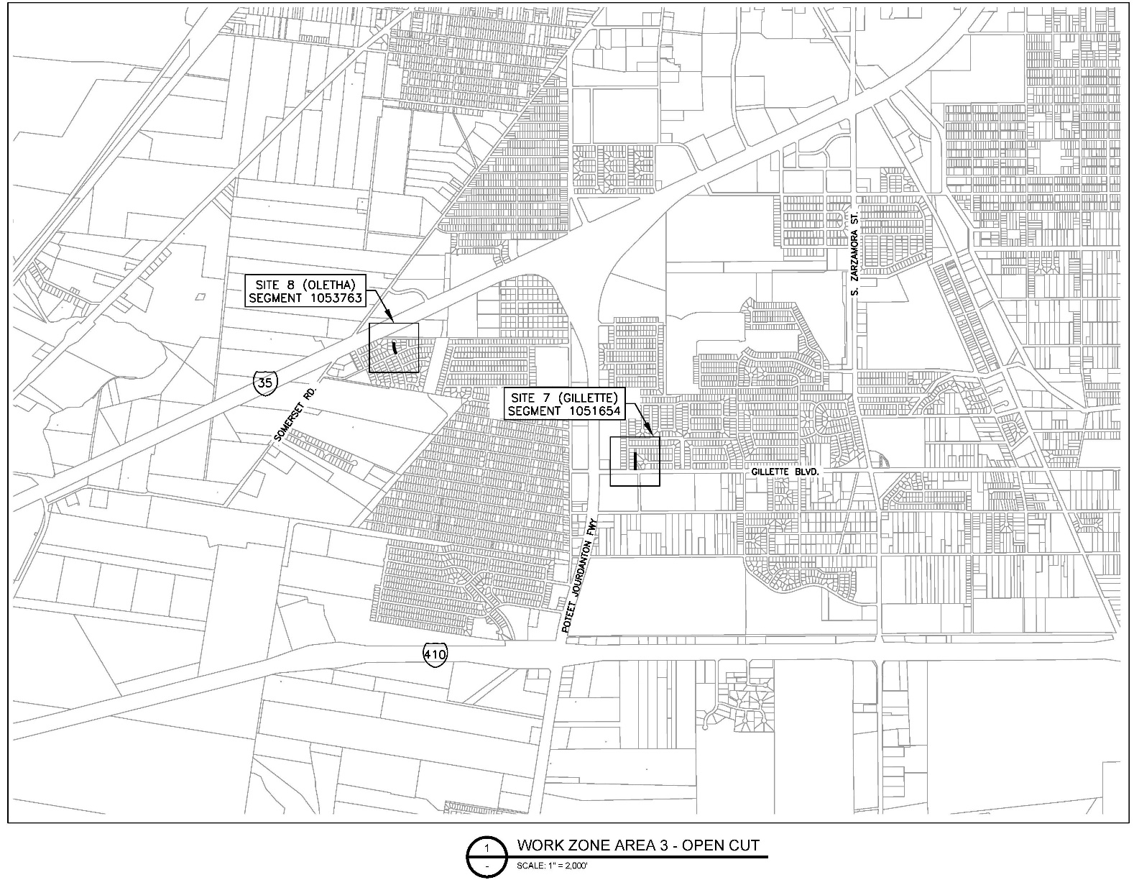
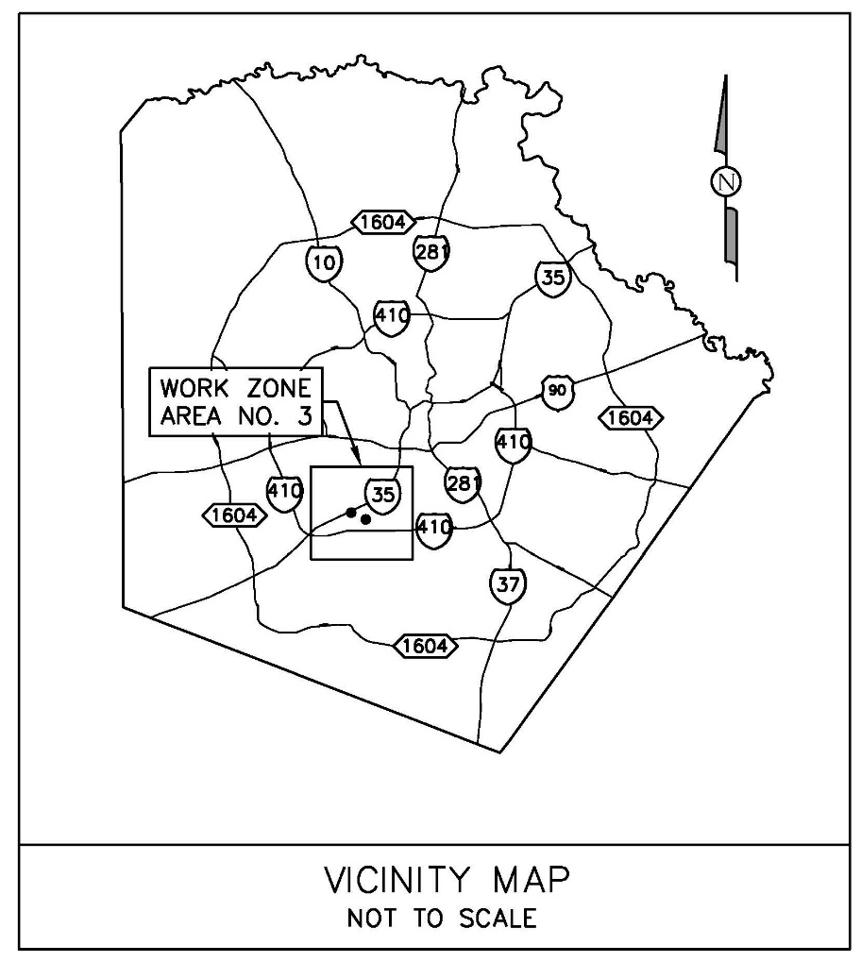
Location (Work Zone 3)

Slide 24
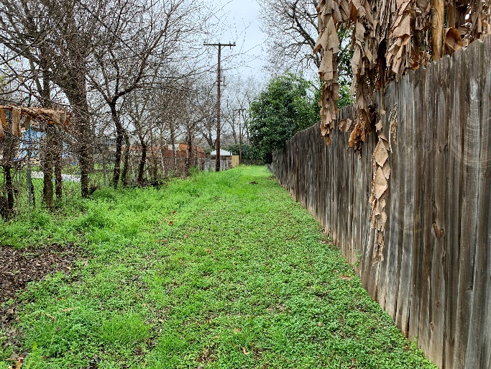
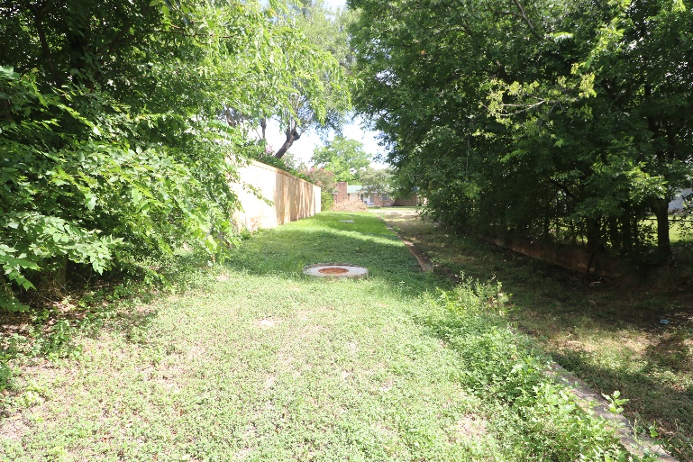
Project Summary
Site 1- La Sabre (Open Cut)
  Remove and replace 223-lf of 8-inch Sewer Main
  Remove and replace 2 MHs (Drop MH and MH at new Location)
  Sewer lateral and cleanout installation
  16-ft Alley ROW

Slide 25
Project Summary
Site 2, 3, & 4- Hall Park (Open Cut)
  Remove and replace 1,164-lf of 8-inch Sewer Main
  Remove and replace 6 MHs
  1 new MH
  Sewer lateral and cleanout installation
  16-ft Utility Easement (Private Residential Property)
    Construction Right-of-Entry/Work Areas
    Remove and Replace Fencing/Temporary Fencing Requirements
    Scheduling: Sites 2 and 4 at Hall Park should be completed simultaneously due to their close proximity to each other. Site 3 should be scheduled immediately before or after.

Slide 26
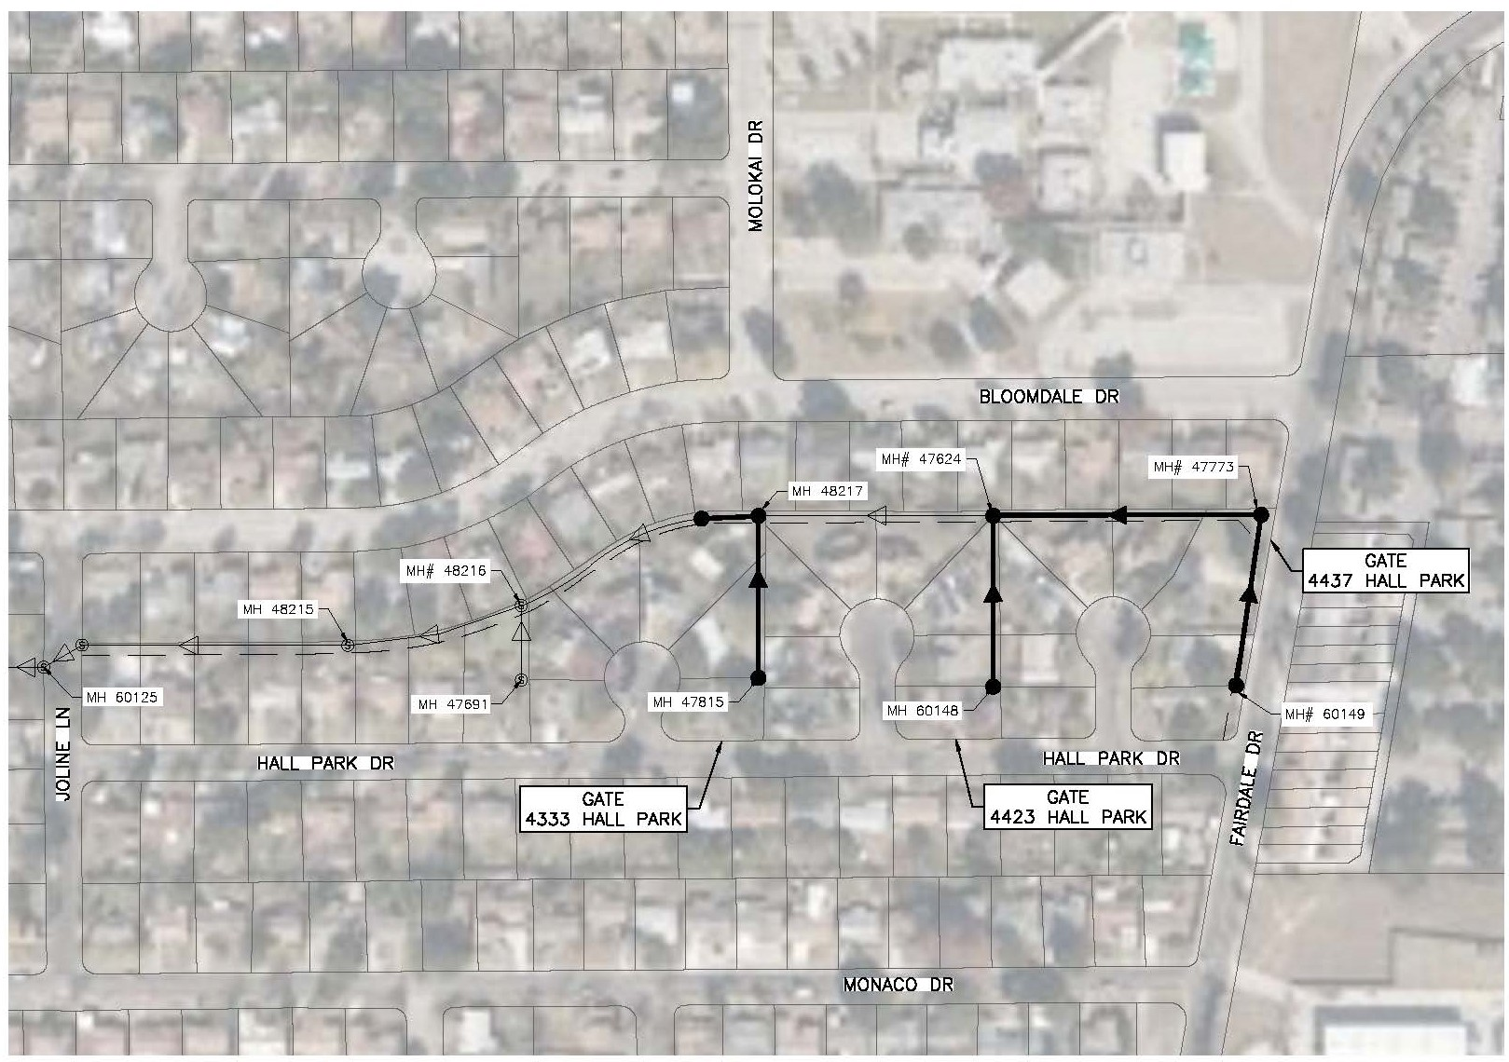
Site 2, 3, & 4 Accessibility

Slide 27
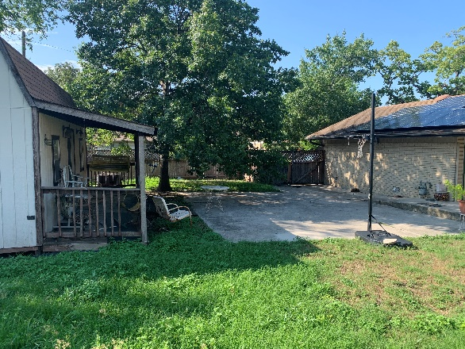
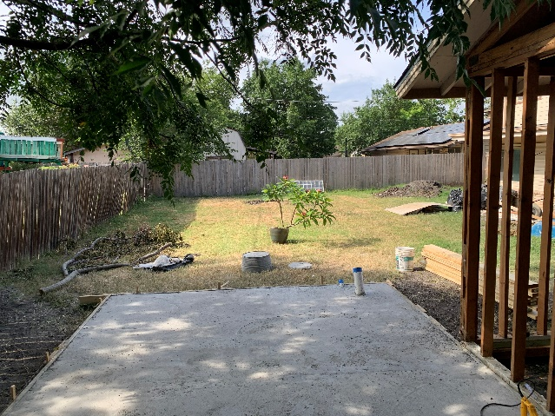
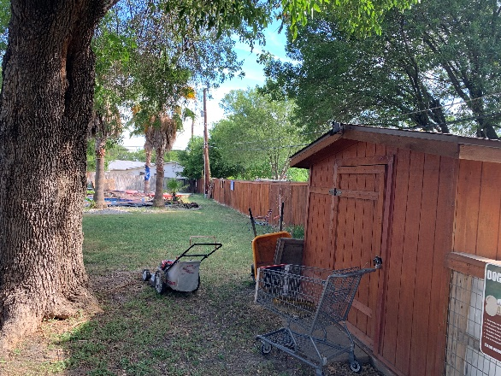
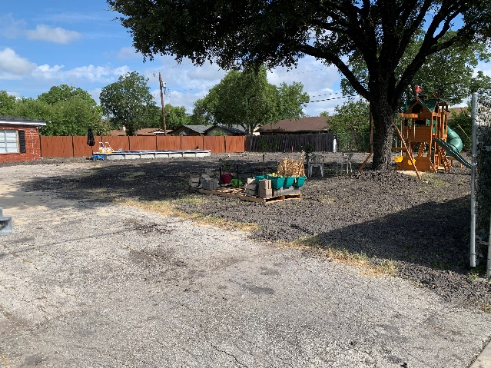
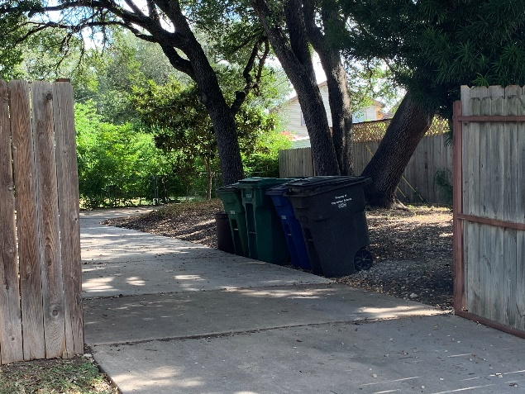
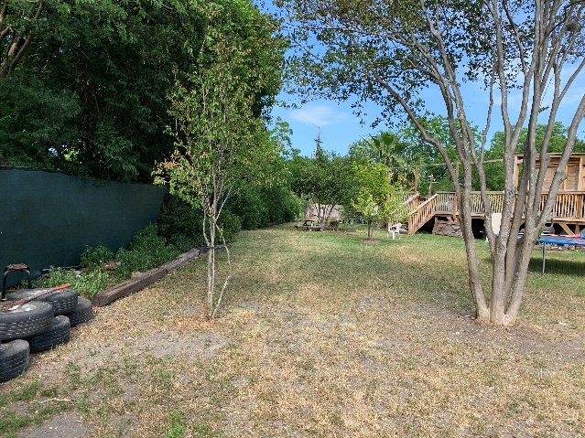
Hall Park Pictures
  4423 Hall Park
  4421 Hall Park
  4419 Hall Park
  4437 Hall Park
  4333 Hall Park
  4329 Hall Park

Slide 28
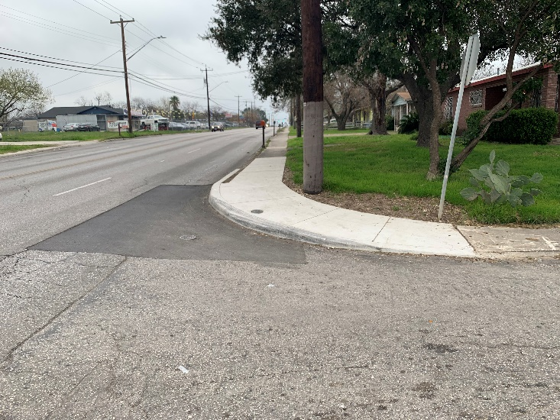
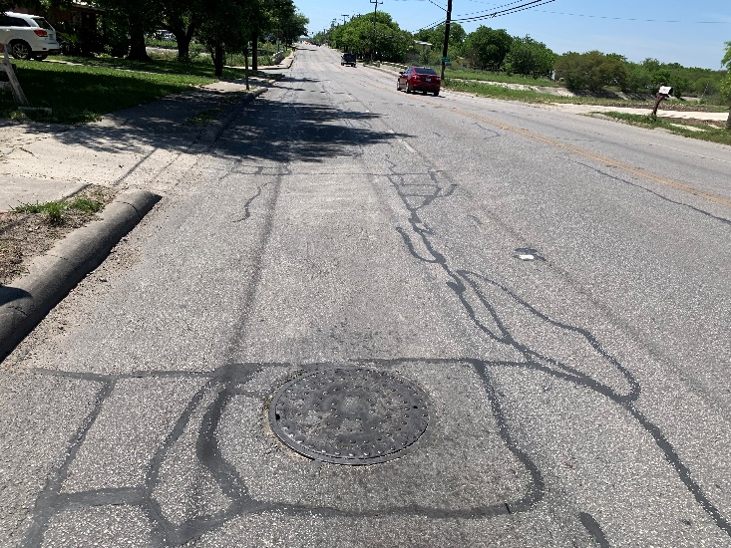
Project Summary
Site 5- W. Commerce St. (Open Cut)
  Remove and replace 182-lf of 8-inch Sewer Main
  Remove and replace 2 MHs
  Sewer lateral and cleanout installation
  Concrete Encase 8-inch Sewer Main (182-ft).
  12-inch Water Crosses Sewer Main
  12-inch Water Main Parallel to Sewer Main
  MH 34512 for suggested bypass in floodplain (FPDP – SAWS obtained)
  Street ROW (W. Commerce St.)

Slide 29
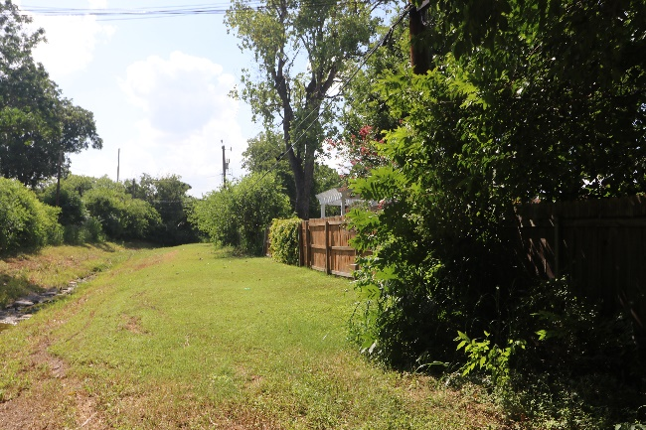
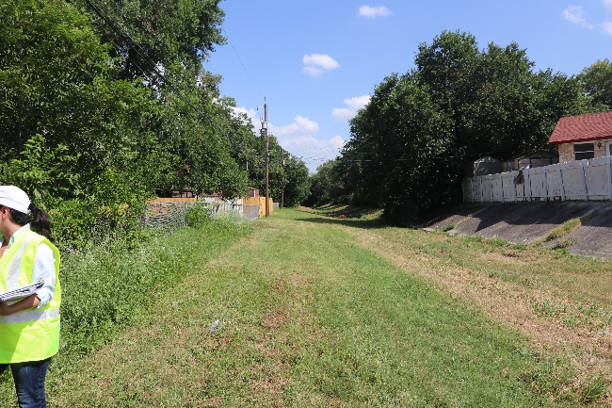
Project Summary
Site 6- Darwin (Pipe Bursting)
  Pipe Bursting 1,469-lf of 8-inch Sewer Main
  Manhole Reconstruction (1)
  Manhole Rehabilitation (5)
  Service Lateral Replacement w/Conc Encasement
  16-ft Utility Easement (Drainage Channel)

Slide 30
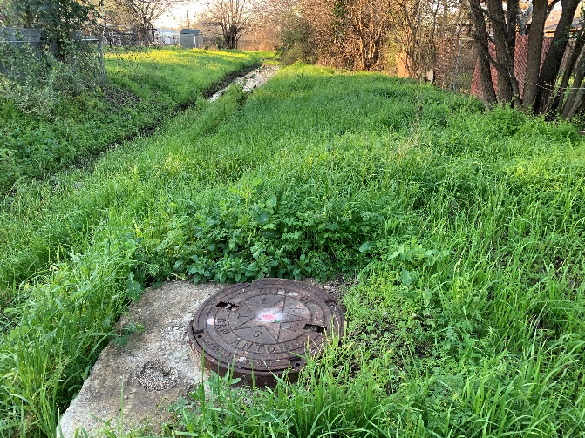
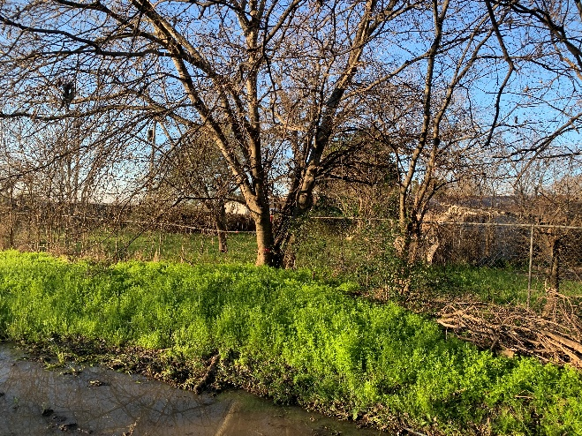
Project Summary
Site 7- Gillette (Open Cut)
  Remove and replace 398-lf of 8-inch Sewer Main
  Remove and replace 3 MHs (1 drop MH)
  Sewer lateral and cleanout installation
  16-inch Water Line Crossing
  Two trees to be removed (COSA Tree Permit – SAWS obtained)
  16-ft Utility Easement (Drainage Channel)
  16-ft Utility Easement (Private Residential Properties)
  Street ROW (Gillette Blvd.)

Slide 31
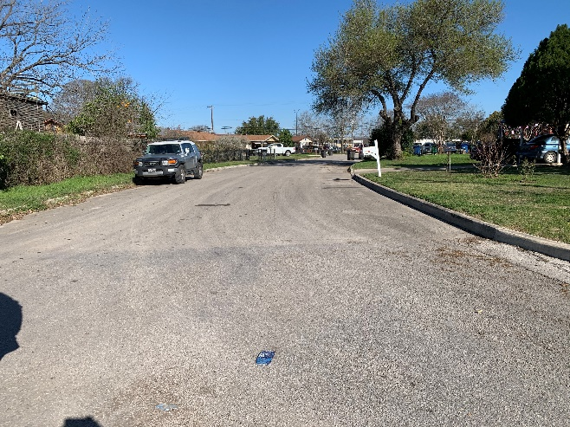
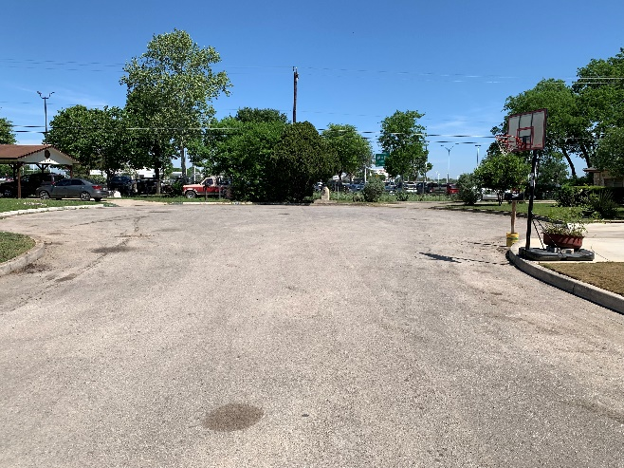
Project Summary
Site 8- Oletha (Open Cut)
  Remove and replace 249-lf of 8-inch Sewer Main
  Remove and replace 2 MHs
  Rehabilitate 1 MH
  Sewer lateral and cleanout installation
  Street ROW (Oletha St.)

Slide 32
Contact Information
Contact Name | Title | Telephone Number | Email address
Roxanne Lockhart | Contract Administrator | 210-233-3095 | Roxanne.Lockhart@saws.org
Marisol Robles | SMWVB Program Manager | 210-233-3420 | Marisol.Robles@saws.org
REMINDER
Please be advised that Bidders are prohibited from communicating with any other SAWS staff, the Consultant, the Developer, or City of San Antonio officials regarding this IFB up until the contract is awarded as outlined in the Instructions to Bidders

